Slide 1


K.RAMAKRISHNAN COLLEGE OF TECHNOLOGY
(AUTONOMOUS), TRICHY.
DEPARTMENT OF
COMPUTER SCIENCE AND ENGINEERING
20CS5501 DESIGN PROJECT-1
Batch No. : 16
Date : 05.12.2025

Slide 2
VOICE ASSISTANT FOR DESKTOP
Guided by Team
Ms.P.Karthika,M.E Deepak Madhu kumar N(811721104026)
Assistant Professor, CSE Fadheeluddeen K (811721104040)
Siva Saravanan kkv (811721104307)

Slide 3
OBJECTIVE
Task Automation: Enable users to perform routine desktop operations such as opening applications, and play videos using voice commands.
Accessibility Enhancement: Provide an alternative input method to assist individuals with disabilities or those seeking hands-free interaction
Integration with Applications: Facilitate seamless voice-based control of common desktop applications like browsers, camera and calculator.
Natural Language Understanding: Employ NLP to interpret user commands accurately, ensuring a conversational and intuitive user experience.
Personalization and Efficiency: Offer customizable voice commands and real-time responses to improve user productivity and cater to individual needs.

Slide 4
ABSTRACT
A Voice Assistant for Desktop, a software solution that enables users to interact with their desktop environment using voice commands. By leveraging Natural Language Processing (NLP) and speech recognition technologies, the assistant will facilitate seamless execution of routine tasks, such as opening applications, searching the web. The system is designed to improve accessibility, particularly for users with disabilities, by offering a hands-free alternative to traditional input methods. Additionally, it enhances productivity by streamlining multitasking and automating repetitive operations. The assistant integrates with commonly used desktop applications to provide a cohesive user experience and supports customization to accommodate individual preferences. With real-time response capabilities and an intuitive interface, the Voice Assistant for Desktop promises to simplify user interactions with their computer while making technology more inclusive and efficient.

Slide 5
LITERATURE SURVEY
TITLE OF THE PAPER (AUTHOR) | OBSERVATION | ADVANTAGES | DISADVANTAGES
Voice-Based Intelligent Personal Assistant Using Artificial Intelligence P. Rajasekhar, P. Kalyani | CLI-based scripts to create a lightweight voice assistant by integrating system commands and simple scripting. | Easy setup, no internet dependency | Limited functionality and no NLP capabilities.
Customizable Voice Assistant for Task Automation R. Prasad, S. Nair | Cloud Services use APIs for speech-to-text and NLP, processing audio on external servers | High accuracy, scalable, easy to integrate | Internet required, cost, privacy concerns
A Review on AI-Powered Virtual Assistants M. Krishnan, A. Gupta | Prebuilt Frameworks like Mycroft AI and Rasa provide ready-made modules for quick voice assistant development. | Faster development, open-source flexibility | Learning curve, framework limitations
Speech Recognition and Command Processing for Personal Assistants T. Deshmukh, K. Ramesh | Machine Learning Models use custom models for speech, NLP, and text-to-speech. | Highly customizable, cutting-edge performance | Requires expertise, resource-intensive

Slide 6
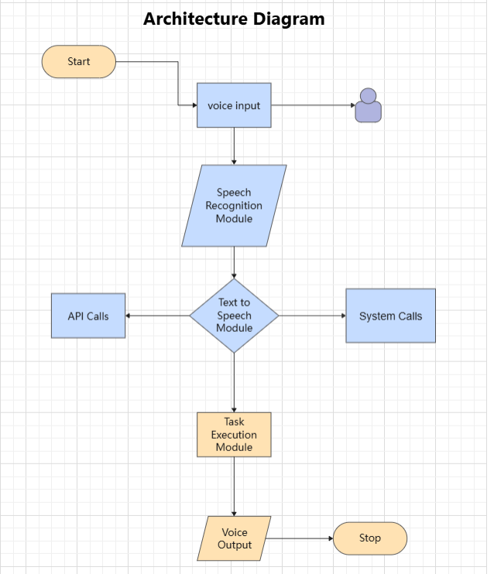
EXISTING SYSTEM ARCHITECTURE

Slide 7
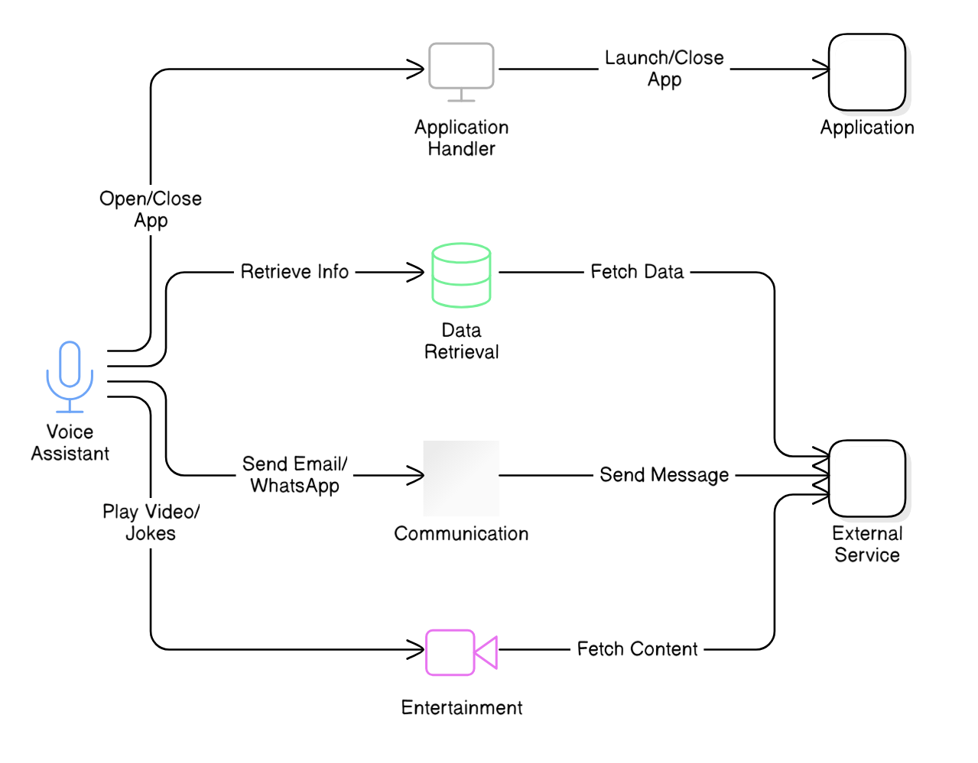
PROPOSED SYSTEM ARCHITECTURE

Slide 8
SOFTWARE AND HARDWARE REQUIREMENTS
HARDWARE
SOFTWARE
Processor – Intel i3 or Higher.
RAM – 4GB or Higher.
Storage – 150 GB
Microphone
Speakers or Headphones
Python
Java Script

Slide 9
MODULES
Data Collection and Preprocessing
Model Development
User Interface
Ethical Considerations
Deployment and Sustainability

Slide 10
Data Collection and Preprocessing
1.To build a desktop voice assistant, collect diverse speech and text data, then preprocess it by normalizing,
2.cleaning, and labeling to train accurate speech recognition and NLP models. Ensure continuous improvement by integrating user feedback and updating models regularly.

Slide 11
Model Development
Model development for a desktop voice assistant involves creating and fine-tuning models for speech recognition and natural language processing.
Develop a speech recognition model to convert voice commands into text using techniques like acoustic modeling and language modeling. Simultaneously, train an NLP model to understand and interpret these commands, classifying intents and extracting entities to execute tasks effectively. Regularly test and refine these models using real-world data to improve accuracy and performance.

Slide 12
User Interface
Voice Interaction: Activation button or command, with auditory feedback for listening and processing.
Visual Feedback: Status indicators and optional real-time transcription display.
Command Input: Microphone button for voice input, with optional text input.
Response Output: Clear text display and text-to-speech for spoken responses.
Settings: Customization options and help instructions.
Accessibility: Keyboard shortcuts and legible design for all users.

Slide 13
Ethical Considerations
Transparency: Clearly disclose data usage and storage.
Privacy: Securely handle and protect user data.
Consent: Obtain and respect user consent for data collection.
Bias: Avoid and address algorithmic biases.
Security: Ensure robust protection against breaches.
Accessibility: Make the assistant usable for all, including those with disabilities.
User Control: Allow users to manage their data easily.

Slide 14
Deployment and Sustainability
Deployment: Ensure easy installation, cross-platform compatibility, and seamless updates.
Sustainability: Monitor performance, optimize resource use, ensure scalability, and provide ongoing support and maintenance.

Slide 15
RESULTS AND DISCUSSION
Testing Outcomes:
User Feedback:
Seamless integration of speech recognition and text-to-speech modules.
Real-time voice command processing and accurate response generation.
Efficient and responsive desktop interface performance.
Improved user experience with intuitive voice command navigation.
High accuracy in recognizing and executing user instructions.
Enhanced productivity with hands-free interaction capabilities.

Slide 16
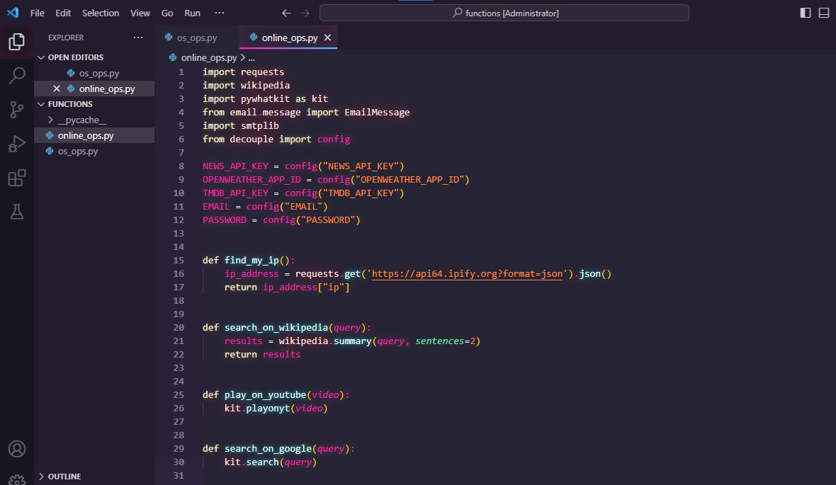
Implementation of Modules

Slide 17
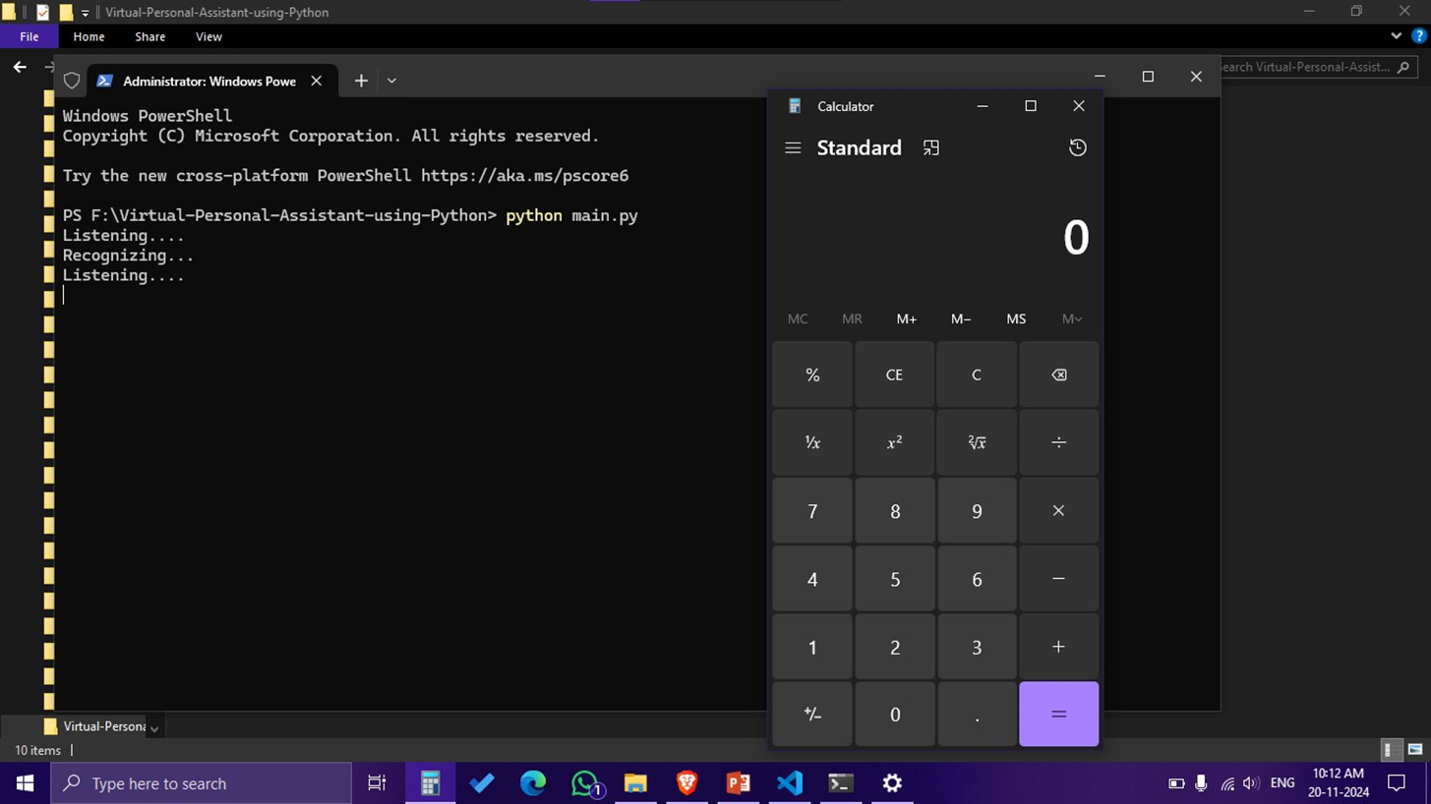
Implementation of Modules

Slide 18
CONCLUSION
In conclusion, developing a desktop voice assistant involves integrating effective speech recognition and natural language processing models with a user-friendly interface. Prioritizing ethical considerations, such as privacy and bias reduction, is crucial for user trust. Successful deployment requires ensuring compatibility, ease of installation, and robust update mechanisms, while sustainability depends on ongoing performance monitoring and efficient resource management. By addressing these aspects, you can create a reliable, responsive, and ethical desktop voice assistant that enhances user productivity and experience.

Slide 19
THANK YOU

